Slide 1

COREXA
Private. Powerful. AI for Every Business.

Slide 2
Problem
Small and medium businesses are being left behind in the AI revolution.
High Costs: Most AI tools are designed for large enterprises with big budgets.
Privacy Risks: Cloud-based solutions raise compliance and data security concerns.
One-Size-Fits-All: Generic AI models don’t reflect unique workflows, language, or sector-specific needs.
Technical Barriers: Many SMBs lack in-house AI expertise.
AI remains out of reach for the very businesses that could benefit most, stifling growth, innovation, and competitiveness.

Slide 3
Solution
We provide physical infrastructure, with an optimisation for inference (e.g. higher end GPUs), we then provide AI models specifically designed for customer’s sector and proprietary data. After the handover, the customer maintain full control over privacy and compliance. With an intuitive interface and flexible architecture, it delivers enterprise-grade AI speed and consistency without the complexity, cost, or cloud dependency, this making powerful automation accessible, secure, and tailored to each business’s unique needs.
On-Premise Deployment
Custom-Trained Models
Easy to Use
Affordable & Scalable

Slide 4
Market Size
$195 billion
$15.6 billion
$156 million
Global SMB AI market in 2024 Total Addressable Market
Data-sensitive SMB sectors Serviceable Available Market
5-year capture 1% of SAM Serviceable Obtainable Market

Slide 5



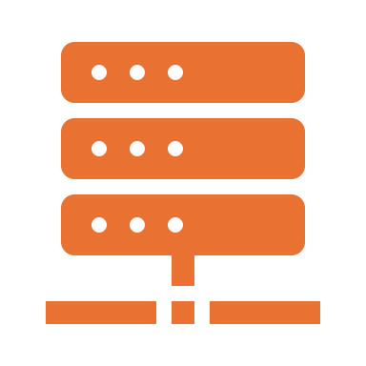
Product
Search by Scale → Select Sector → Train Model → Deploy it!
Alternative to other services, we provide a tailor-made solution, after a customer requests a proposal, we give them an automatic estimated quote. If the customer then goes ahead, we initiate our onboarding process which includes scheduled meetings, data transfers and refinement. We then deploy on their premises, which it would be fully in their domain, with an option to have a yearly service contract.

Slide 6

Business Model
We take a 20% commission from each deployment.
22,500
SMB Customers
£5K
£112M
High Performance Computers with Corexa
Share of Market
AVG configuration fee
Based on Median Spec Model
Revenue
Conservative Estimate

Slide 7
Market Adoption
Partnership Strategy
System Integrators
IT consultancies serving SMBs
Technology Partners(NVIDIA, Dell, Microsoft)
AI Model (Google Gemma, Meta Llama, Mistral AI, OpenAI OSS)
Professional associations (FCA, HIMSS, ILTA, RSNA)
Event Marketing
Target Events Monthly
AI & Big Data Expo
FinTech Connect
Advanced Engineering Show (manufacturing/engineering)
Enterprise AI Summit (business decision makers)
London Tech Week
Digital Marketing
Multi-Industry
Campaigns
LinkedIn Targeted Campaigns
Industry Publication Sponsored Content
Professional Email Nurturing
Enterprise AI Summit (business decision makers)
Webinar Series

Slide 8
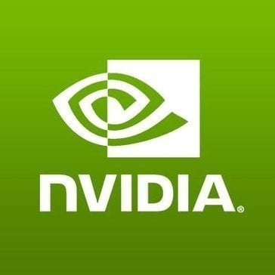
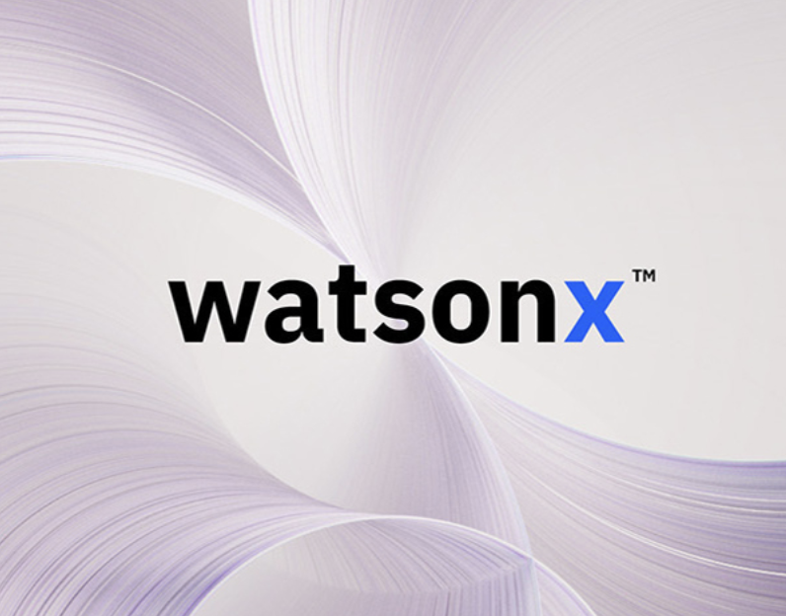

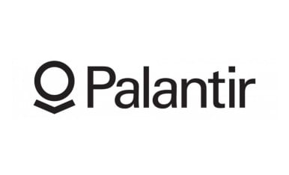
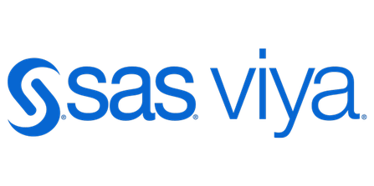

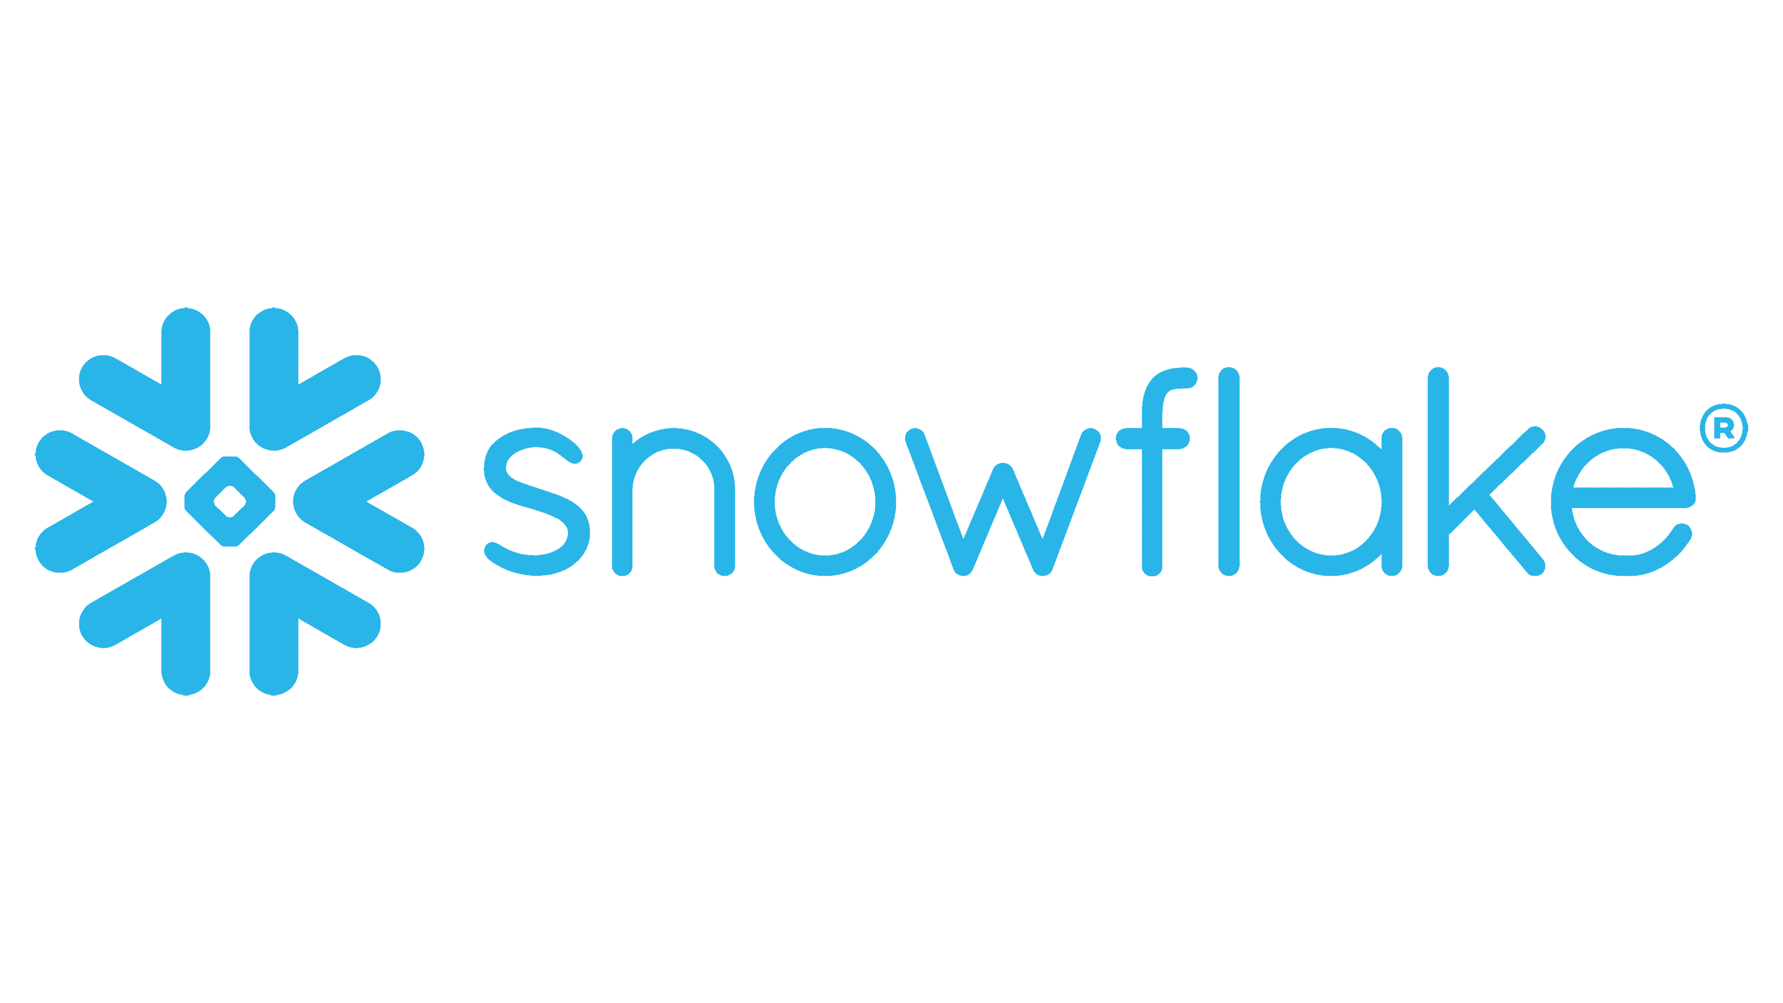
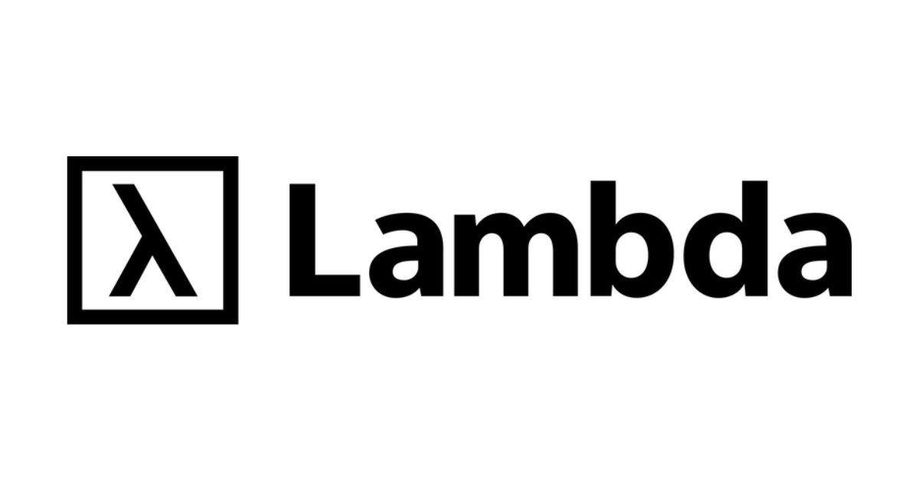




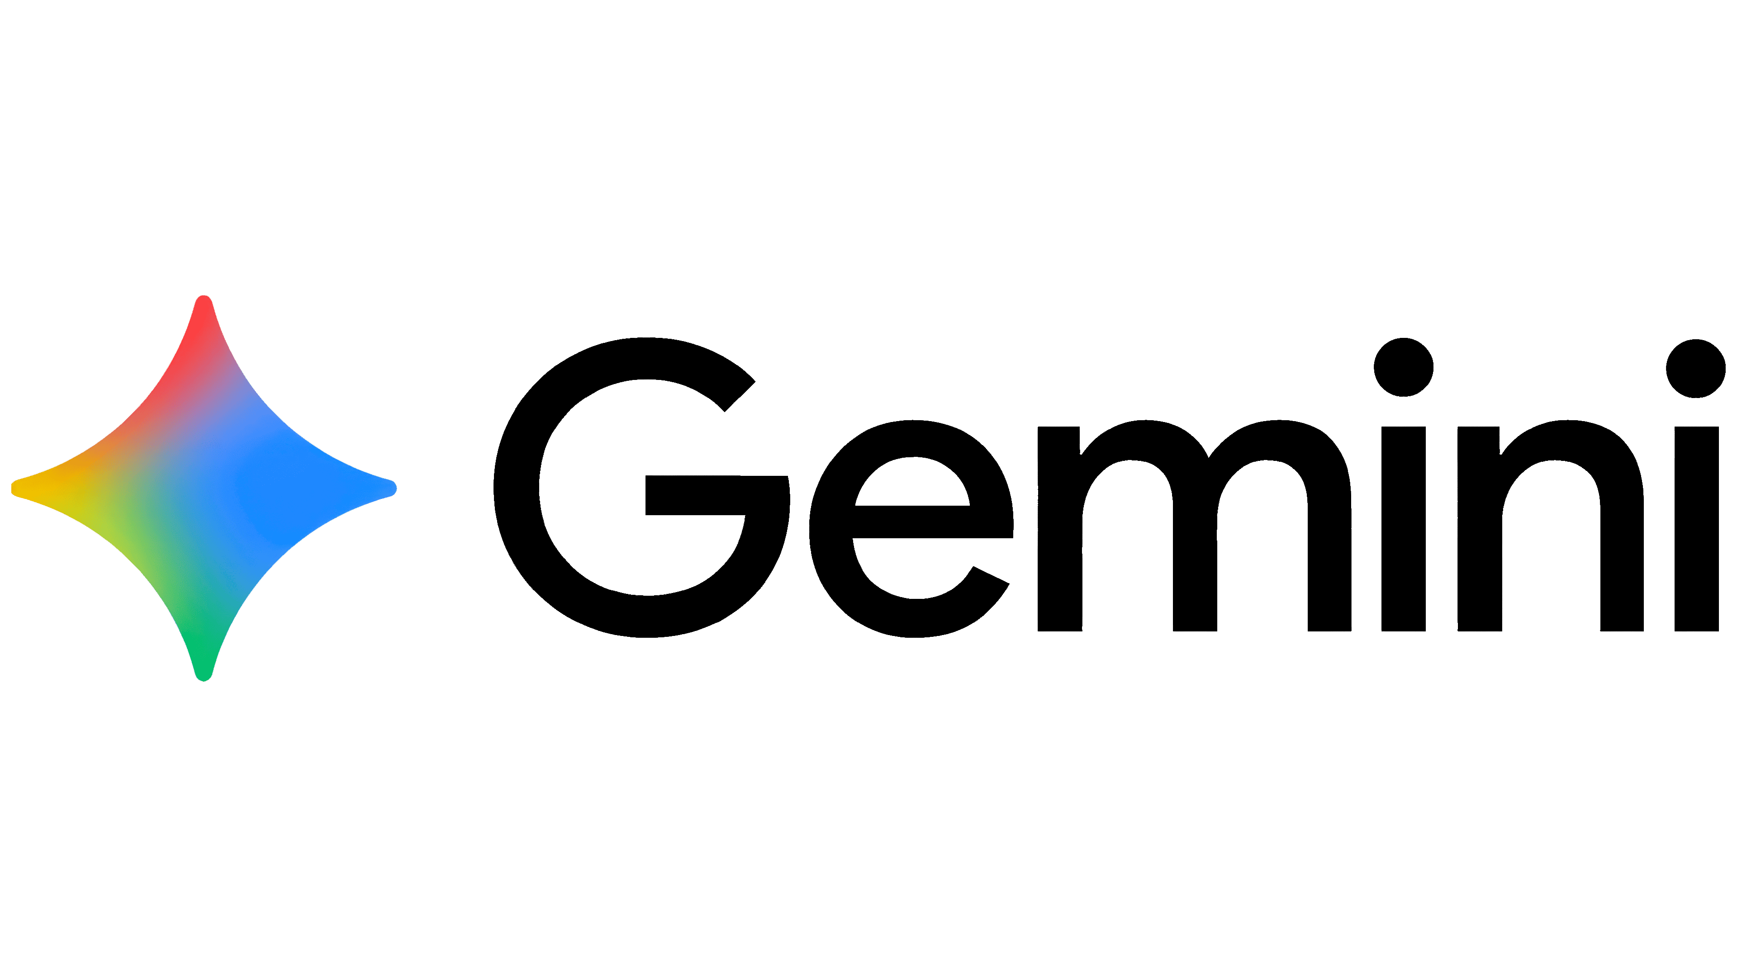

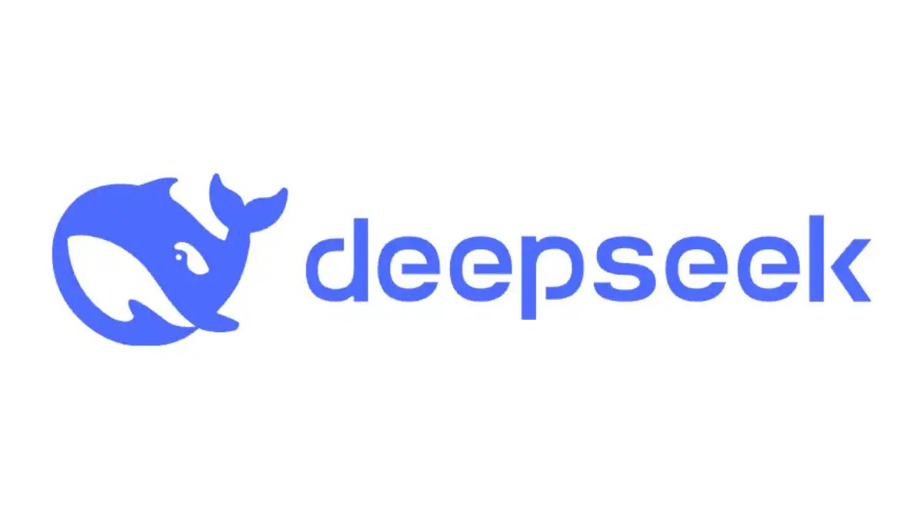
Competition
High Cost
On-Premises Deployment
Cloud Deployment
COREXA
Low Cost

Slide 9
Competitive Advantages
1. SMB-FIRST APPROACH
Purpose-built for mid-market companies (50-500 employees) with enterprise AI needs but SMB budgets and complexity requirements.
2. TOTAL DATA CONTROL
Zero cloud dependency ensures complete data privacy - perfect for regulated industries requiring confidentiality.
3. COST ADVANTAGE
10x less expensive than enterprise solutions with no ongoing API costs and predictable £25K pricing.
4. RAPID DEPLOYMENT
30-day implementation vs 12+ months for enterprise platforms, with turnkey support included.
5. INDUSTRY EXPERTISE
Pre-configured for manufacturing, finance, healthcare, and legal with built-in compliance frameworks.
6. PROVEN ROI MODEL
Clear revenue model with 20% commissions and £5K per deployment targeting the underserved SMB market.

Slide 10

Any Questions

